Slide 1
AI Fundamentals, MMAI 5000 S4B – Machine learning – Supervised ML Decision Tree Hemant Sangwan

Slide 2
Agenda – Supervised Machine learning
Discuss methods, examples, and applications of Supervised ML
Decision Trees
Bagging (Random Forests, RF)
Boosting (AdaBoost, XGBoost)

Slide 3
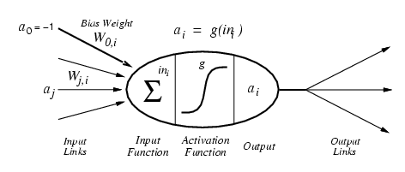
Machine Learning – Definition
"Machine learning is a field of computer science that gives computers the ability to learn [from data] without being explicitly programmed." Wikipedia

Slide 4
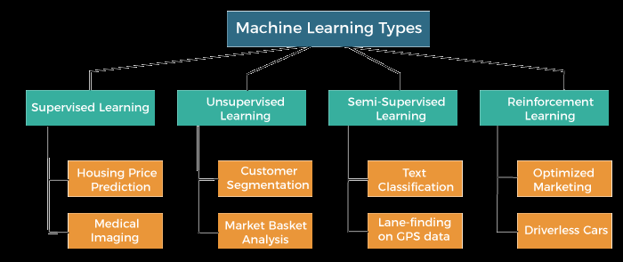
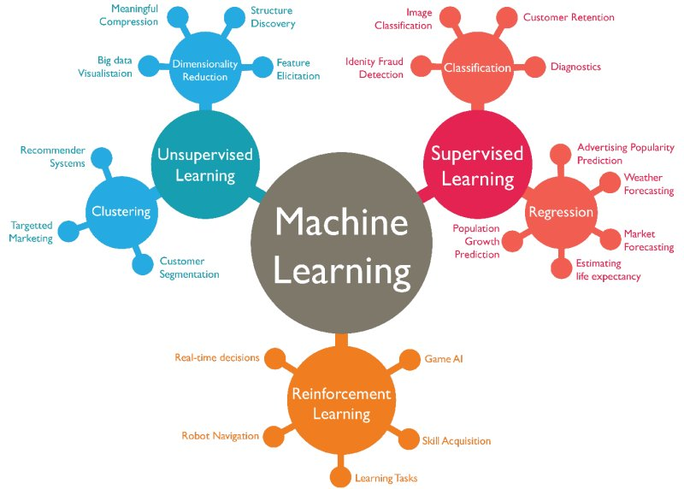
Machine Learning – Types and applications
Source: https://www.javatpoint.com/types-of-machine-learning
Source: https://www.kdnuggets.com/2019/04/poll-data-science-machine-learning-methods-algorithms-use-2018-2019.html

Slide 5
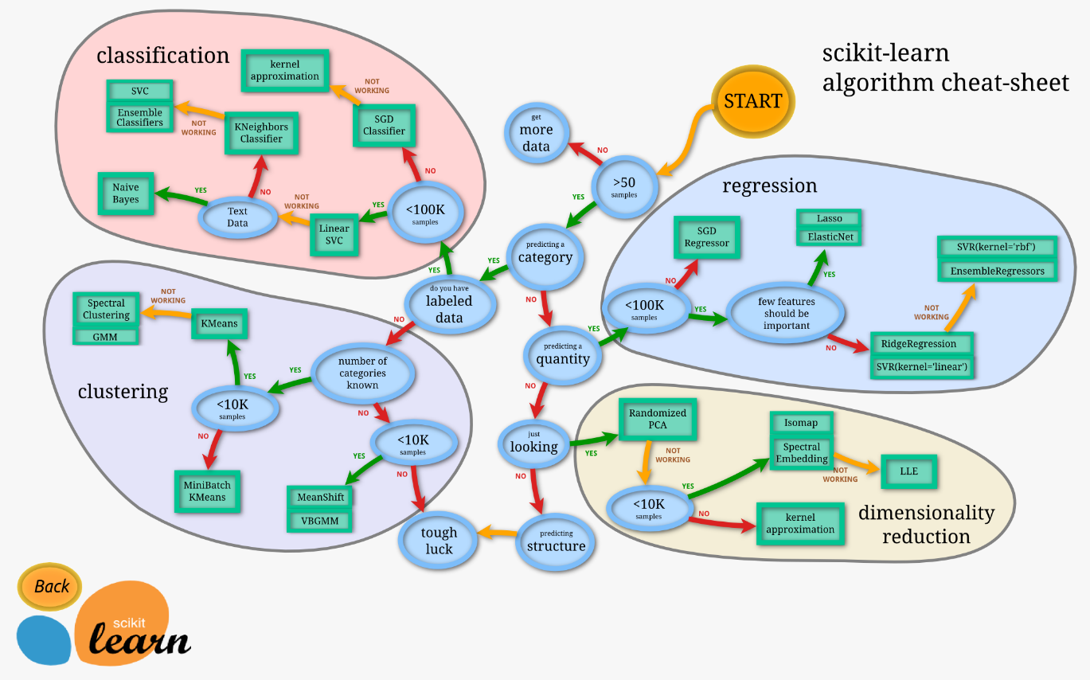
Machine Learning – Algorithms
Source: https://scikit-learn.org/stable/tutorial/machine_learning_map/index.html

Slide 6
Machine learning – Supervised
Machine learning – a program that learns from experience
Supervised: The computer is “taught” with examples of desired inputs and outputs and goal is to learn from “input-output” relationships
Assume an unknown function f that returns output y given some input X, i.e., y = f(X)
Supervised learning: learn a function h that approximates f. y ≈ h(X)
X= price, y= sales OR X = price, y = purchase or no purchase (categorical variable)

Slide 7
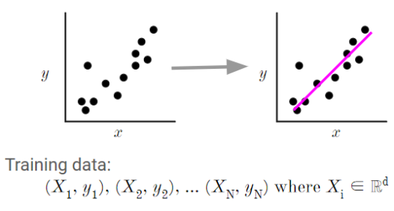
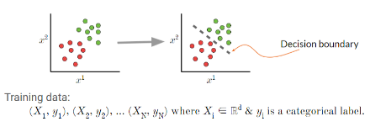
Machine learning – Supervised
An unknown function f that returns output y given some input X, i.e., y = f(X)
Supervised learning: learn a function h that approximates f. y ≈ h(X)
Correct output known for each training example, i.e., data are labeled and the algorithm learns h that approximates f
X= price, y= sales; OR X = price, y = purchase / no purchase (categorical variable)
X= independent variable or feature, y = dependent variable or outcome
Question – What is the target variable in each of the figures given here?
and yi ∈ ℝ.

Slide 8
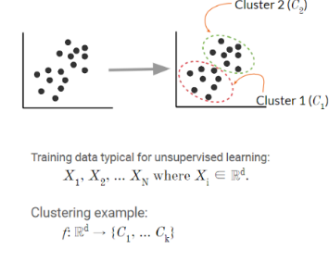
Machine learning – Unsupervised
Machine learning – a program that learns from experience
Unsupervised: The computer is “left on its own” to find structure in the data and learn the relationships between various inputs
It create an internal representation of the input, capturing regularities/structure/patterns in data, i.e., unlabeled data, i.e., no distinction between dependent and independent variables
Question – What is the target variable in the figure given here?

Slide 9
A few other types of learning
Classic: supervised, unsupervised, reinforcement
Hybrid:
Semi-supervised: a few labelled and many unlabeled data
Self-supervised: unsupervised learning with a supervised learner (e.g., language model)
Learning techniques
Multi-task learning: Supervised learning predicting multiple targets
Transfer learning: Train on one task and use the model on another task (often after fine-tuning)
Online learning: Update (train) the model as new data arrives

Slide 10
Machine learning – Supervised vs Unsupervised
Supervised
You are an investment analyst at a boutique firm in downtown Toronto. One of your clients loves investing in gold and thinks gold provides the best hedging against inflation than investing in stocks. The client provided you with the data on GP (gold price index), TSX index, and CPI (inflation index)
If your client’s brief is correct → gold prices rise faster than TSX relative to inflation. How to establish such relationship between (GP/CPI) or (TSX/CPI)
Predict GP (or TSX) as a function of CPI, i.e., if CPI rises by 1%, how much GP (or TSX) will rise?
UnSupervised
Your team has collected data on 150 financial ratios used to measure health of a firm. The client has asked if there is a way to reduce 150 ratios to 10 categories/indices to simplify the task and present it to the CEO?
10 indices should be able to capture almost all information which is available in 150 different types of ratios
Predict which specific category (10 categories) each ratio is going to be assigned to?

Slide 11
Decision Trees (DT)

Slide 12
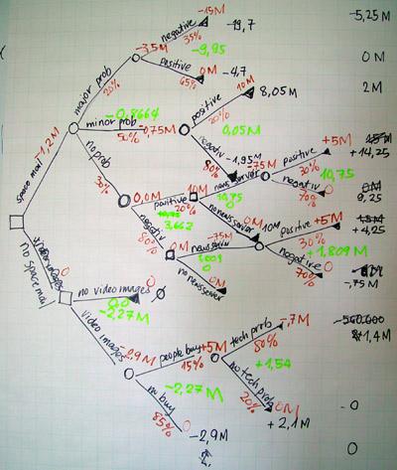
Decision Trees
Source: Image credit: By Gokul Jadhav - Public Domain, https://commons.wikimedia.org/w/index.php?curid=4404547

Slide 13
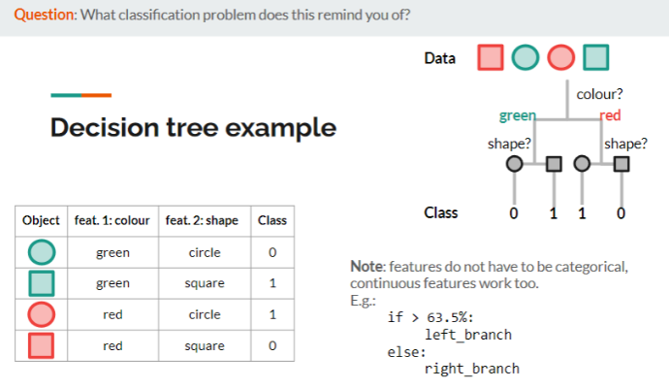
Decision Trees – Examples
Which feature was most important in the example here?
What makes this learning algorithm greedy?

Slide 14
Learning in Decision Trees
Learn by a greedy divide-and-conquer strategy
Test the most important feature first, i.e., the feature that makes the most difference to classification
Build the tree by applying the above rule recursively (i.e., repeatedly on the remaining features)
Greedy search is meant to approximately minimize the depth of the tree
How to measure feature importance: Entropy and Gini index
Entropy
Measures the uncertainty of a random variable
The feature resulting in the greatest gain in information is selected first

Slide 15
Entropy and feature selection
The feature resulting in the greatest gain is used first
Entropy of a random binary variable q (e.g., coin flips): H(p)= - (p log p+(1-p) log (1-p))
R (x)= Entropy remaining after using feature x with k levels (i.e., feature splits the data into k branches)
Information gained by using a feature G (x) = H - R (x)

Slide 16
Overfitting in Decision Trees
Overfitting: the model does not generalize to new data or does not generalize findings
Learn a decision tree to predict if the roll of a die will come up as 6
Features: die colour, die weight, time of roll, and if fingers were crossed
Note: none of these features are predictive of the outcome of a fair die, thus the tree should not have any branches and always predict False (i.e. not 6)
The training data contains random irregularities
E.g., 2 rolls with colour: blue, weight: 7 gram, fingers crossed and outcome 6
Even though there are no relations between the feature values and the outcome, the learning algorithm will split the tree on randomly occurring patterns
However, new data (not in the training set) will likely not include the same random patterns, so the predictions will be wrong
In other words, the model doesn’t generalize to new data. It is over fitted to the training data

Slide 17
Over and underfitting in Decision Trees (DT)

Slide 18
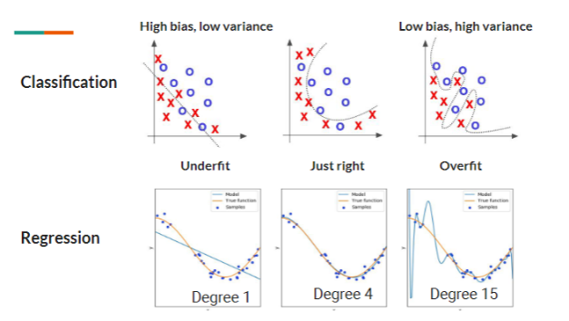
Over and under fitting – Bias and variance tradeoffs
“With four parameters I can fit an elephant, with five I can make him wiggle his trunk”
John Von Neumann

Slide 19
Overcoming overfitting
Regularization
Lower the number of features (often used for linear regression)
Lower the number of parameters or depth of decision trees
Reduce the magnitude of parameters (good for many features that all contribute a bit to predicting the target)
Early stopping: Stop training when validation errors increase

Slide 20
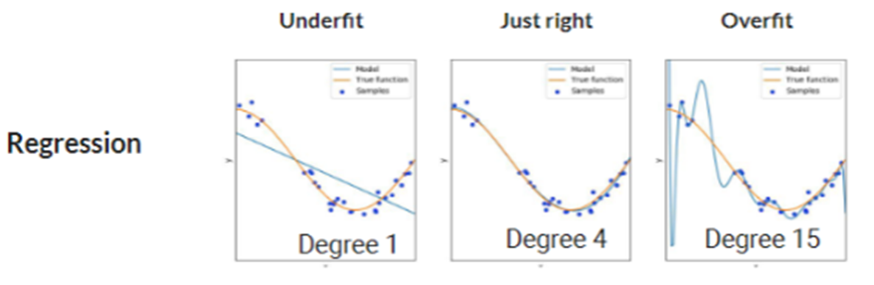

Regularization – Regression
Regression – fit a polynomial
1st degree: h_{w} (x) = w₁x + b
2nd degree: h_{w} (x) = w₁x + w₂x² + b
Nth degree h_{w}(x) = w₁x + w₂x² + …+ w_{n}x^{n} +b
Minimize combined regression error and regularization term
Lambda (λ): Regularization parameter. It measures trades off between minimizing data error and “simple” model
Parameters that do not contribute much to minimizing the prediction error get smaller
h_{w}(x) = w₁x + w₂x² + … w_{n-1}x^{n-1} + w_{n}x^{n} +b; i.e., w_{n-1} w_{n}→ 0

Slide 21
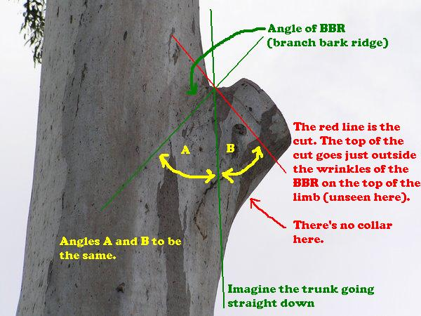
Regularization – Decision Tree
Pruning
No weights and cost functions in DT, i.e. the regularization method used for regression does not work
Instead, the tree is pruned by removing nodes with too small information gain
Source: Pruning by Eric Frei. Retrieved from https://en.wikipedia.org/w/index.php?curid=15837493

Slide 22
Bagging (Ensemble learning)

Slide 23
Crowd sourcing – wisdowm of crowds!
In 1906, 800 individuals participated in a contest to guess the weight of an ox at a livestock fair
Galton observed that the median weight was within 0.8% of the true weight, much better than the average individual guess, i.e., the crowd was wiser than any individual
If estimates (e.g. guesses of the ox’s weight) have random, independent errors, then averaging the guesses will decrease the total error
In machine learning different models give different errors:
An ensemble model combines several individual models for better predictions
Ensemble methods combine weak learners, i.e. models that are just a little better than chance, for predictions that are much better than chance

Slide 24
Bagging decsion trees
Bootstrap aggregating – an ensemble meta algorithm
Learn several decision trees on different subsets of training data and average (or majority vote) their predictions
The assumption of uncorrelated errors is critical!
for l in range(L):
Sample with replacement N; X_{L}, Y_{L}
Learn a tree h_{L} on X_{L}, Y_{L}
Average prediction across trees

Slide 25
Random Forests (RF)
Random forests is a random subspace method
Learn several decision trees on different subsets of features and average (or majority vote) their predictions
The assumption of uncorrelated errors is critical!
for l in range(L):
Sample d features from D (d < D)
Sample with replacement N; X_{L}, Y_{L}
Learn a tree h_{L} on X_{L}, Y_{L}
Average predictions across trees

Slide 26
Boosting (Ensemble learning)

Slide 27
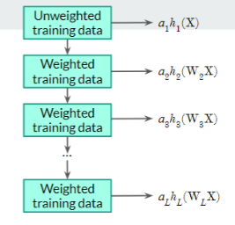
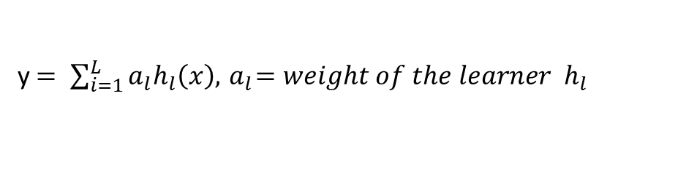
Boosting – higher weights to better learners
The bagging and the random forest algorithm give an equal weight to all trees
What if some trees are better, i.e. reduce the error more, than other?
Boosting: gives better learners higher weight than poor learners. i.e. combine learners with a weighted sum
AdaBoost (Adaptive boosting)
Two sets of weight: a and W, W= weight for the data points in training set
The data points that were misclassified by previous learners get higher weight, i.e., lower weights to easy data points and larger to difficult ones
W focuses on making subsequent learners focus on misclassified examples
y$= \sum_{i=1}^{L}{a_{l}h_{l}\left(x\right),{ a}_{l}=weight of the learner{ h}_{l}}$

Slide 28
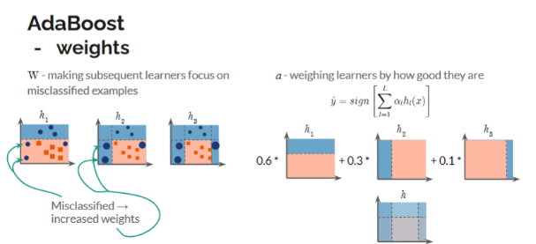
AdaBoost – Example

Slide 29
Boosting – other examples
XGBoost – A top performing algorithm in machine learning competitions
Decision tree-based ensemble algorithm
A highly optimized implementation of gradient boosting
Lots of enhancement for speed, performance and convenience
Gradient boost – Errors are minimized by gradient descent

Slide 30
Model selection and evaluation

Slide 31
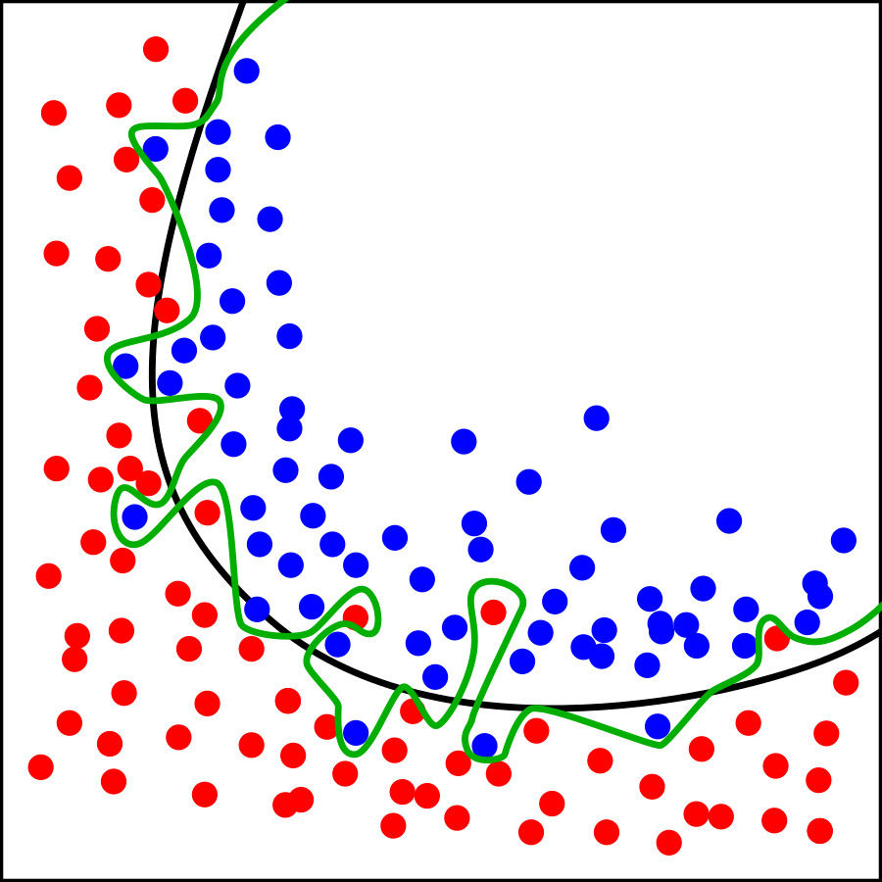
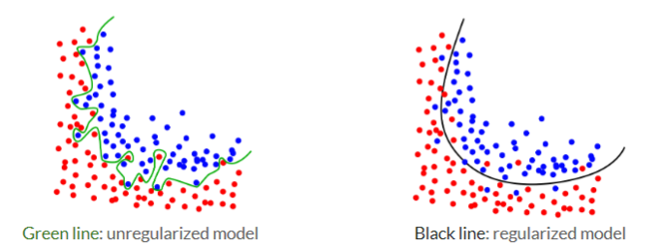
Model selection and evaluation
Which of the two models will perform best on the training data?
Which of the two models will perform best on previously unseen data (i.e. not training data)?
Source: https://commons.wikimedia.org/w/index.php?curid=3610704

Slide 32
Model selection and evaluation
How can we do model selection if we’re can neither use the training set nor the test set?
Model selection = best model among different algorithms and hyper parameter settings is called model selection
Model performance on the training data is irrelevant (only useful for training)→ model selection should not be based on training set
Model selection based on performance on test data → over fitting as performance will no longer be representative for unseen data → we should not use the test set for model selection
We need a third set – a validation set

Slide 33
Model selection and evaluation – data partitioning
Training set (e.g. 60% of total data set): Used to learn model, e.g. fit weights and/or learn trees
Validation set (e.g. 20% of total data set): Used for model selection, e.g. choosing algorithm, tuning hyper parameters or for early stopping (e.g. deciding when to stop building a decision tree or stop training a neural network)
Testing set (e.g. 20% of the total data set): Used only to evaluate the performance of the final model. No decisions should be made based on the test set

Slide 34
Recommended Readings
Decision Trees. Retrieved from https://scikit-learn.org/stable/modules/tree.html
Entropy: How Decision Trees Make Decisions. Retrieved from https://towardsdatascience.com/entropy-how-decision-trees-make-decisions-2946b9c18c8
Model selection and evaluation. Retrieved from https://scikit-learn.org/stable/model_selection.html
A “short” introduction to model selection. Retrieved from https://towardsdatascience.com/a-short-introduction-to-model-selection-bb1bb9c73376

